Slide 1
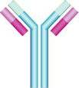
Immunology Biol 465 Minot State University Spring 2020
MWF 9-9:50 am
Lab Tuesdays 9am-noon

Slide 2
Lecture 4 January 24, 2020
Return student papers

Slide 3
Where were we?
Using antigen-antibody interactions in research and as medicine.
Give some examples. Check this out. https://www.hopkinsmedicine.org/news/media/releases/cancer_therapy_that_boosts_immune_system_ready_for_wider_testing
Historical figures in immunology
Name some and their contributions
What is passive immunity?
Give an example

Slide 4
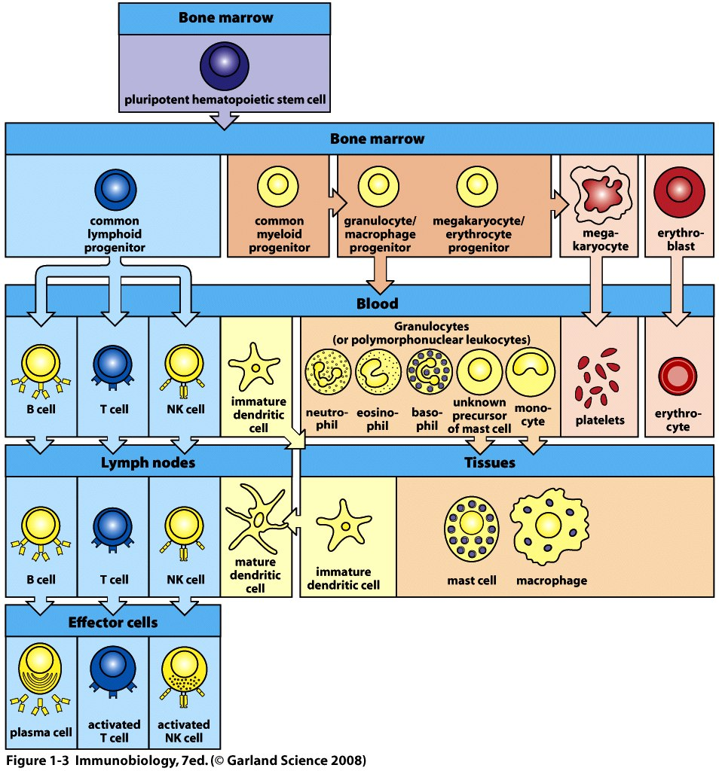
Become very familiar with this figure! Where do our blood cells originate?
Where are they found at each stage?

Slide 5
In general….Cells of the immune system go through 3 life stages:
Development
Activation by antigen or chemical signal
*Effector-–performing the task
*Your text limits the term to lymphocytes, but any cell that becomes activated will have an effect related to ridding the host of the pathogen.

Slide 6
Myeloid cells
1. Granulocytes—Have odd shaped, multi-lobed nuclei and densely staining granules in cytoplasm. Also called Polymorphonuclear leukocytes-PMNs)
3 types
Neutrophils—phagocytes—bacteria fighters
Eosinophils---recognize parasites which are bound to antibodies—kill them.
Basophils—allergic responses, parasites
Mast cells also contain granules but have regular nuclei—release histamine in allergic reaction

Slide 7
Myeloid cells
Monocytes—circulate in the blood and move into tissues to mature into macrophages.
Many roles in innate immunity
Phagocytes—directly engulf pathogens
Trigger inflammation
Activate other cells
Interact with lymphocytes to initiate adaptive responses

Slide 8
Myeloid cells
Dendritic cells
Arguably the most important type of phagocyte in the immune system.
Primary role is to ingest fluid in tissues to obtain a sample of the contents.
Continually present small pieces of proteins (peptides) to T-cells. These antigens may activate the T-cells and initiate an adaptive immune response.

Slide 9
Dendritic cells link innate and adaptive immunity. (Figure 1-5)
Dendritic cells are considered Antigen Presenting Cells (APCs). Since this is their sole purpose, they are sometimes referred to as professional APCs.

Slide 10
Lymphoid cells
B-lymphocytes
T-lymphoctyes
Natural Killer cells
All derived from a common progenitor cell
B and T-cells----adaptive immunity
NK cells---innate immunity.

Slide 11
NK cells
Kill some tumor cells
Kill some virus-infected cells, especially herpes virus.
**Do not express the highly specific antigen receptors like B and T cells

Slide 12
B and T cells
Circulate in blood AND congregate in lymphoid tissues.
B-cells originate and mature in bone marrow
T-cells originate in the bone marrow, but mature in an organ called Thymus
Both express highly variable and specific antigen receptors

Slide 13
Lymphoctyes
B-cells express a B-cell antigen receptor (BCR), which is a membrane anchored antibody molecule. An activated B-cell will eventually secrete the same form of the antibody.
T-cells express a T-cell receptor (TCR), which is membrane anchored and never secreted.

Slide 14
T-cells
3 primary types
Helper T-cells
Cytotoxic T-cells
Regulatory T-cells (We don’t spend much time on these)

Slide 15
Development of lymphocytes
Both B- and T-cells begin in the bone marrow.
Terms—in chronological order…
B-cells---immature, mature, naïve, activated (effector), plasma cells, memory cells.
T-cells---immature, mature, naïve, activated (effector), memory

Slide 16
Lymphoid tissues/organs
Body has different locations of organized tissues containing lymphocytes.
2 main distinctions
1. Central lymphoid organs---Where lymphocytes form and mature.
2. Peripheral lymphoid organs--- Where mature, naïve lymphocytes hang out and where adaptive immune responses are initiated.

Slide 17
Examples…
Central---bone marrow and thymus
Peripheral—lymph nodes, spleen, and tissue-associated lyphoid tissues.
Gut
Nasal/respiratory tract
Urogenital tract

Slide 18
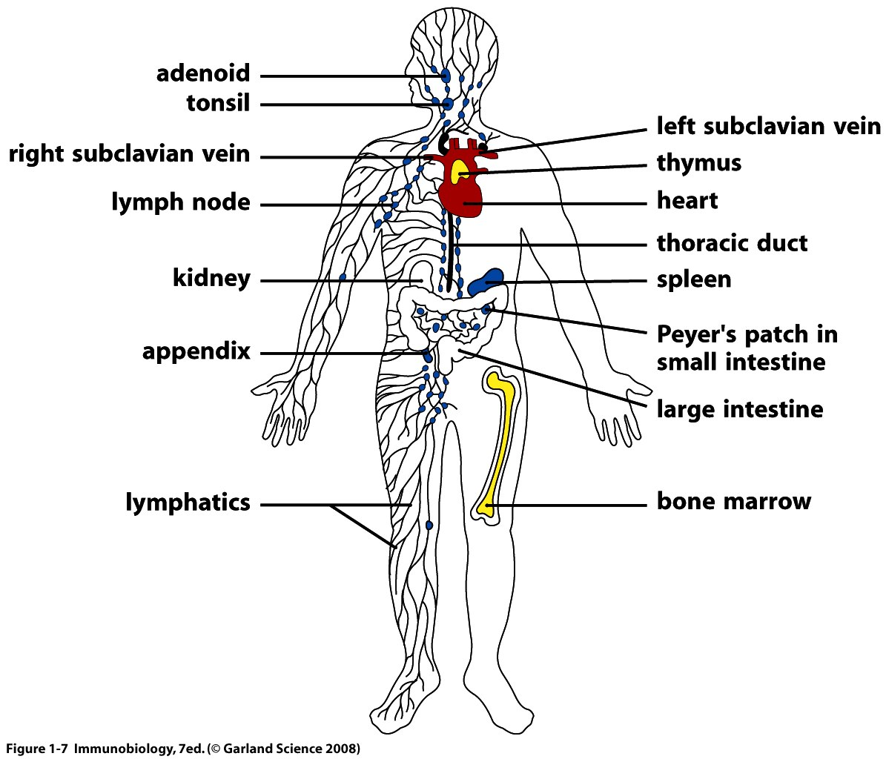

Slide 19
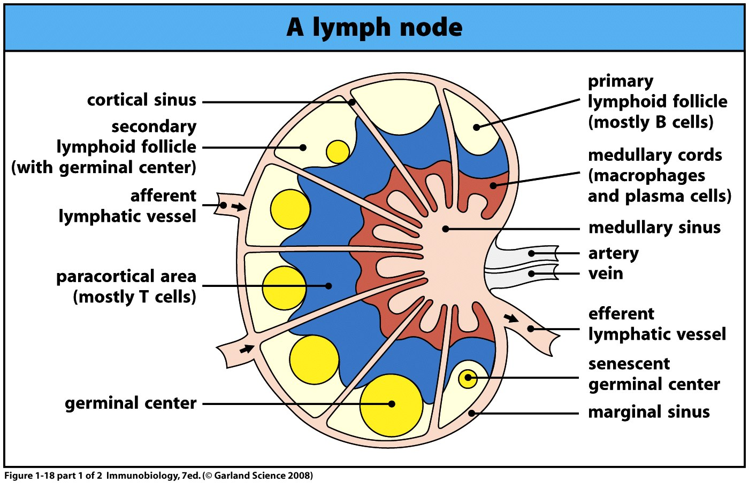

Slide 20
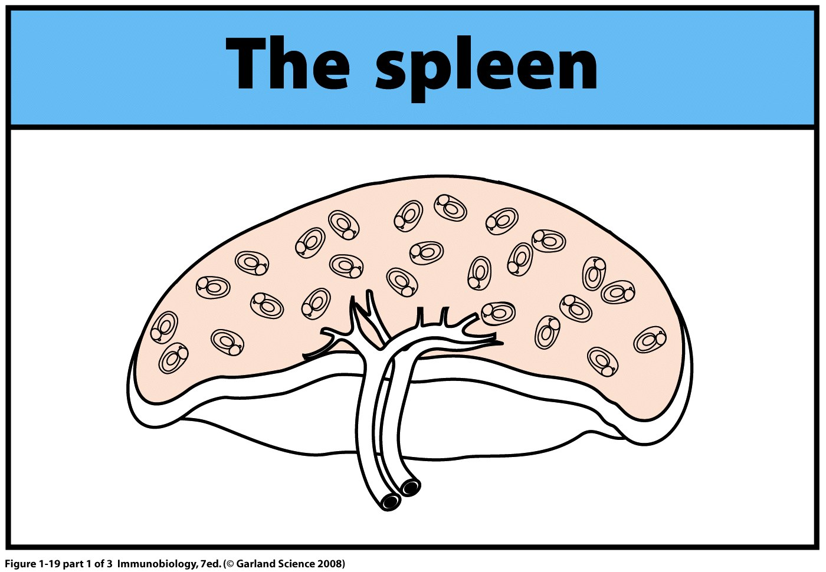

Slide 21
Let’s return to the lymph node and think of its purpose
It allows contact between antigen and antigen receptors. The location of specific cell types allows interactions that spur an adaptive immune response.
Antigen can be transported in.
Cells such as dendritic cells can physically contact T-cells
T-cells can physically contact B-cells

Slide 22
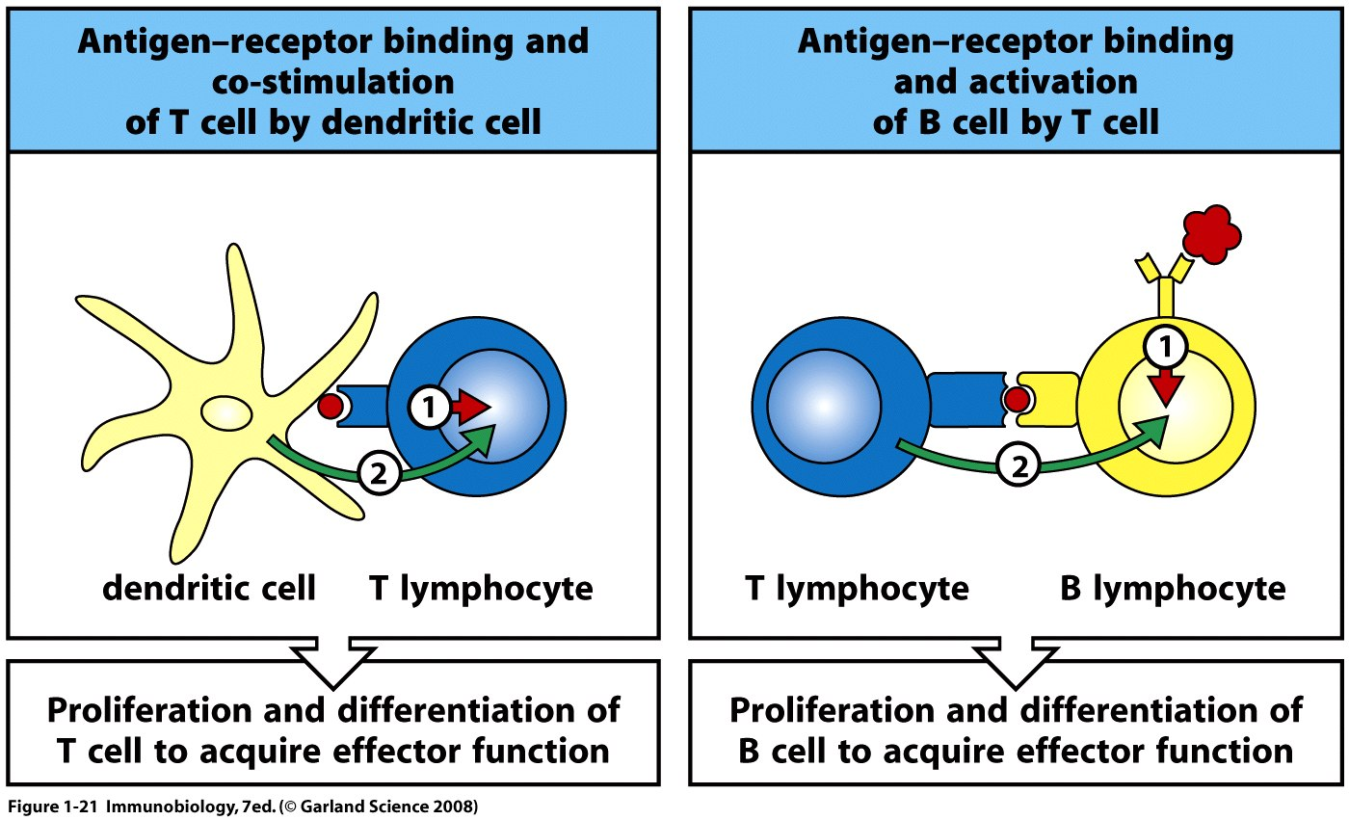
T-cells must be presented
with antigen
T-cells and B-cells interact to initiate and maintain an adaptive immune response

Slide 23
What occurs when antigen matches antigen receptor?
First mass reproduction of that cell---all daughter cells, will, of course, produce the same antigen receptor—these receptors are proteins encoded by the DNA of the cell.
Called Clonal expansion

Slide 24
Example---is development of masses of B-cells in a lymph node.
Called germinal centers.
If the expansion is large, we can notice a “swollen gland”

Slide 26
Chapter 1 includes more detail than we need for now, but let’s briefly discuss the outcome of activation of B and T lymphocytes.
What are the effector mechanisms?...

Slide 27
B-cells
Recall…activation results in clonal expansion---production of lots and lots of B-cells capable of binding the same antigen.
B-cells are good for dealing with extracellular pathogens (like most bacteria) and the potentially harmful molecules they produce.

Slide 28
B-cell produce antibodies
What do antibodies do? 3 main effector mechanisms.
1. Neutralization—binding and blocking the action of toxins, virus particles etc.
2. Opsonization—binding/coating of pathogen to mark it for destruction by other cells
E. Activation of a system called the complement pathway---multi-step process to destroy bacteria.

Slide 29
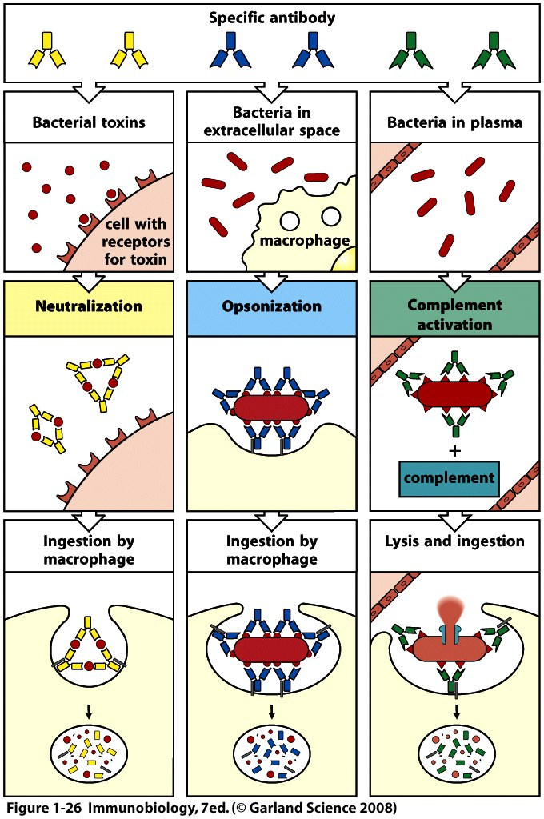

Slide 30
T-cell effector mechanisms
Cell-mediated immunity—requires direct interaction between the T-cell and another host cell.

Slide 31
T-cells differentiate into 2 types of effector cells
Cytotoxic T lymphocytes (CTLs or T_{c})—act directly to kill virus-infected cells. Release of toxins after binding to virus-infected cell.
Express a specific cell surface molecule-- a co-receptor called CD8.
CTLs=CD8+ T-cells.

Slide 32
Helper T-cells=T-helper cells= T_{H} cells
Do not kill pathogen or pathogen-infected cells directly, but activate other cells to their full effector function.
B-cells
Macrophages
CTLs

Slide 33
T_{H} cells
Express a different co-receptor than CTLs
CD4
T_{H} cells=CD4+ T-cells

Slide 34
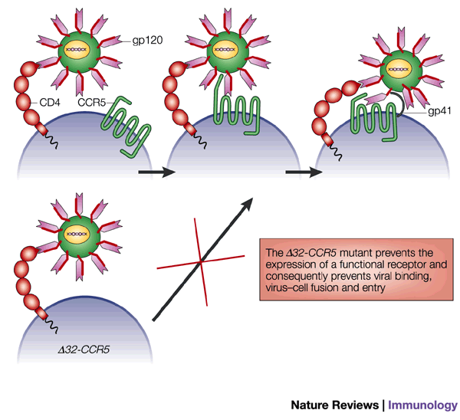
Interesting…
CD4 T-cells are the specific target of the HIV virus. The virus uses the CD4 surface molecule as its receptor to access the cell. The infection kills many T_{H} cells.

Slide 35
The importance of these cells is recognized in the inability of HIV-infected individuals to mount effective immune responses, despite having normal numbers of B-cells and CTLs.
AIDS is the result of a lack of CD4+ T-cells

Slide 36
2 types of T_{H} cells
1. T_{H} 1 cells—specialized for controlling intracellular bacteria—Tuberculosis is caused by a type of bacterium which gets into macrophages. (Most bacteria are extracellular). T_{H} 1 cells activate the macrophage to kill the bacteria

Slide 37
2. TH₂ cells seem to be most important in activating B-cells. So indirectly important in the humoral response.

